Slide 1
JavaScript - language

Slide 2
Download
https://github.com/petereijgermans11/frontend-cursus

Slide 3
Requirements
Must have Node installed !
Must have Chrome installed
Use Visual Studio IDE

Slide 4
Overview
What is JavaScript
What is ECMAScript
JavaScript - the Basics

Slide 5
JavaScript

Slide 6
JavaScript
Object-oriented
Scripting language
Depends on Browser or Node to execute

Slide 7
Client-side
JavaScript can be executed by browsers
The browser extends JavaScript to:
Manipulate DOM (Data Object Model)
Interact with services from the browser

Slide 8
Server-side
Executed by Node
Extended with objects to
Interact with IO
Interact with Sockets

Slide 9
ECMAScript

Slide 10
ECMAScript
Netscape asked Ecma International to create JavaScript specification
Started in 1996, first release in 1997
Notes:
ECMA = European Computer Manufacturers Association

Slide 11
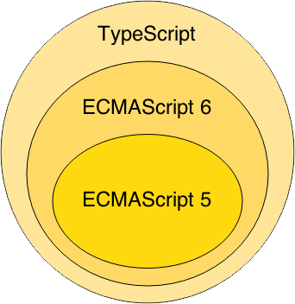

Slide 12
JavaScript
The Basics

Slide 13
Starting point:
MDN Web docs
https://developer.mozilla.org/en-US/docs/Web/JavaScript/Guide/Introduction

Slide 14
What is JavaScript?
cross-platform
object-oriented scripting language
used to make webpages interactive.
Notes:
For example, client-side extensions allow an application to place elements on an HTML form and respond to user events such as mouse clicks, form input, and page navigation.

Slide 15
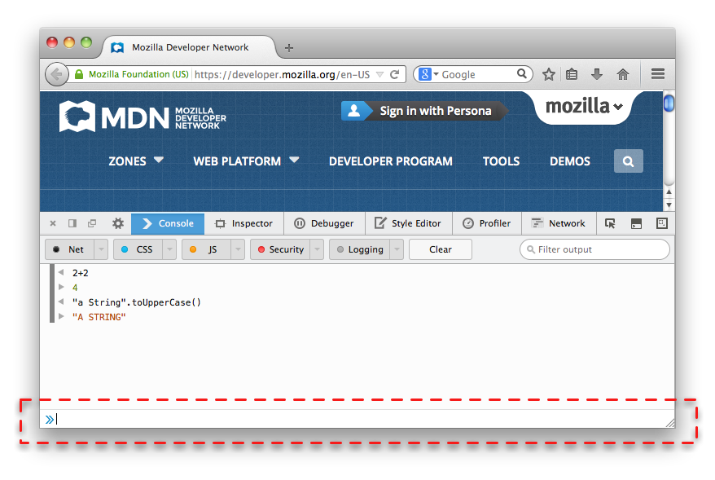
Browser Console
Internet Explorer F12
Firefox Ctrl + Shift + J
Chrome - View > Developer > JavaScript Console
Notes:
Nearly every browser can run JavaScript and most modern browsers now include a JavaScript console that can be used to run snippets of JavaScript code.

Slide 16
Your First JavaScript Program
Type the following in your Browser Console:
console.log("Hello World!");

Slide 17
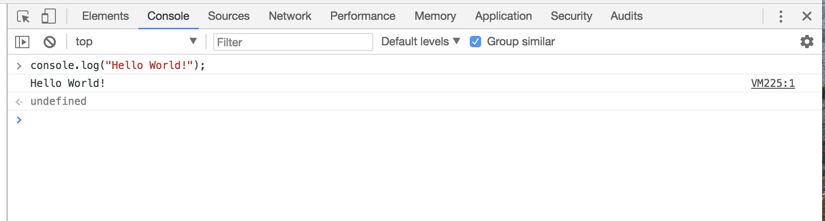

Slide 18
Three Layers of the Web

Slide 19
Keep all of these 3 layers separate !
JavaScript in a .js-file
CSS styling in a .css-file
HTML in a .html-file

Slide 20
Hello world example
https://plnkr.co/edit/?p=preview&preview

Slide 21
Important Guides JS
https://javascript.info/
https://developer.mozilla.org/nl/

Slide 22
Tutorial
https://developer.mozilla.org/en-US/docs/Learn/Getting_started_with_the_web/JavaScript_basics

Slide 23
DEMO

Slide 24
Download
https://github.com/mdn/beginner-html-site-styled/archive/gh-pages.zip
Notes:
Calculator: http://embed.plnkr.co/YB9vnC/

Slide 25
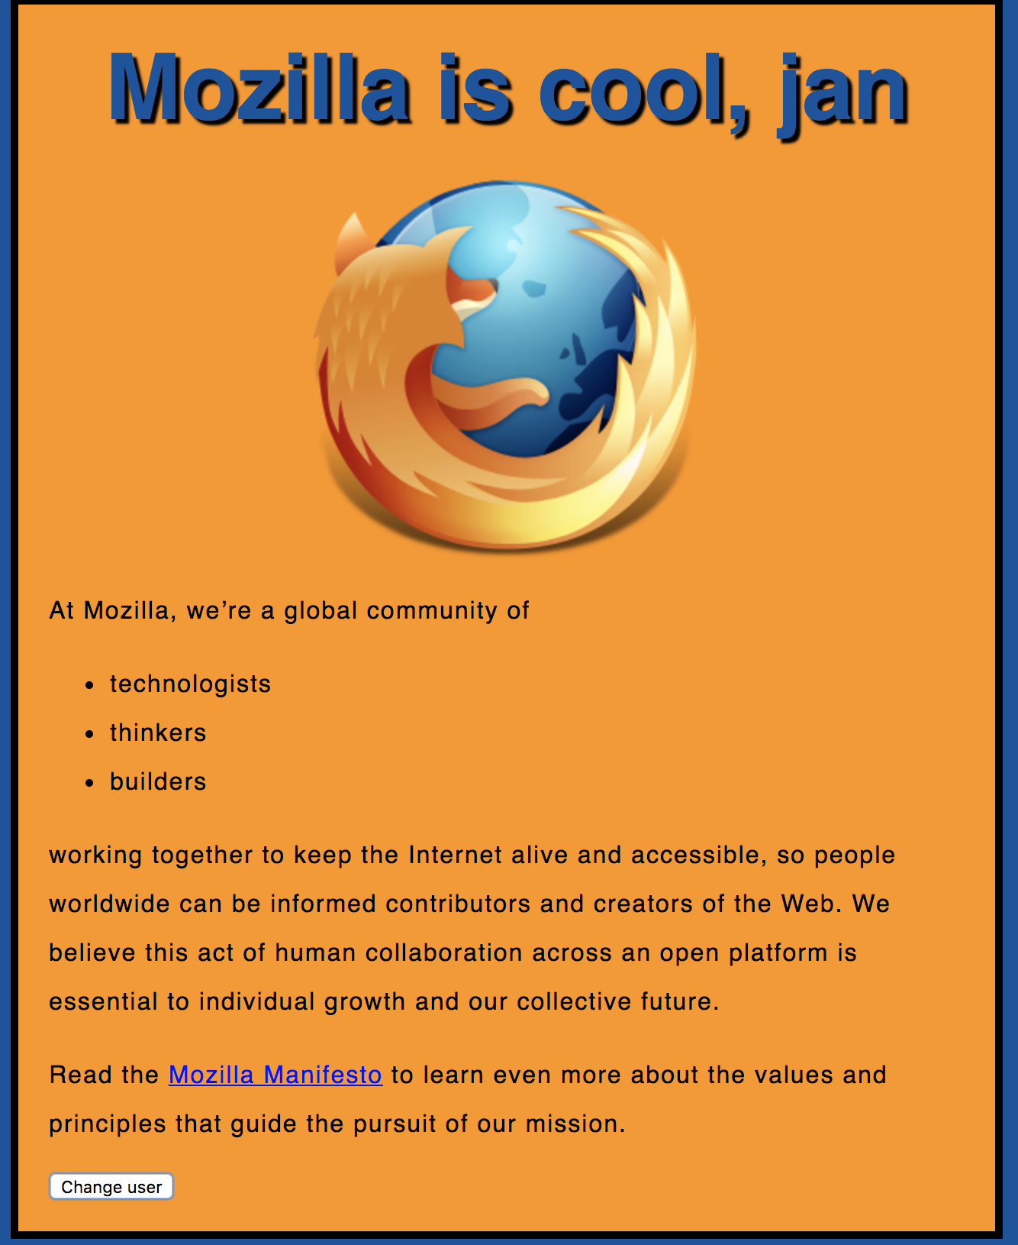
Notes:
https://mdn.github.io/beginner-html-site-scripted/

Slide 26
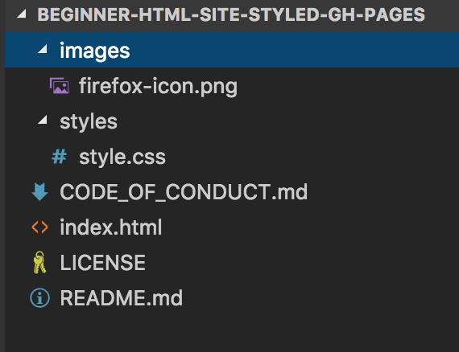

Slide 27
<!DOCTYPE html>
<html>
<head>
</head>
<body>
</body>
</html>
index.html

Slide 28
<!DOCTYPE html>
<html>
<head>
<meta charset="utf-8">
<title>My test page</title>
<link href="styles/style.css" rel="stylesheet" type="text/css">
</head>
<body>
<h1>Hello World!</h1>
<img src="images/firefox-icon.png">
</body>
</html>

Slide 29
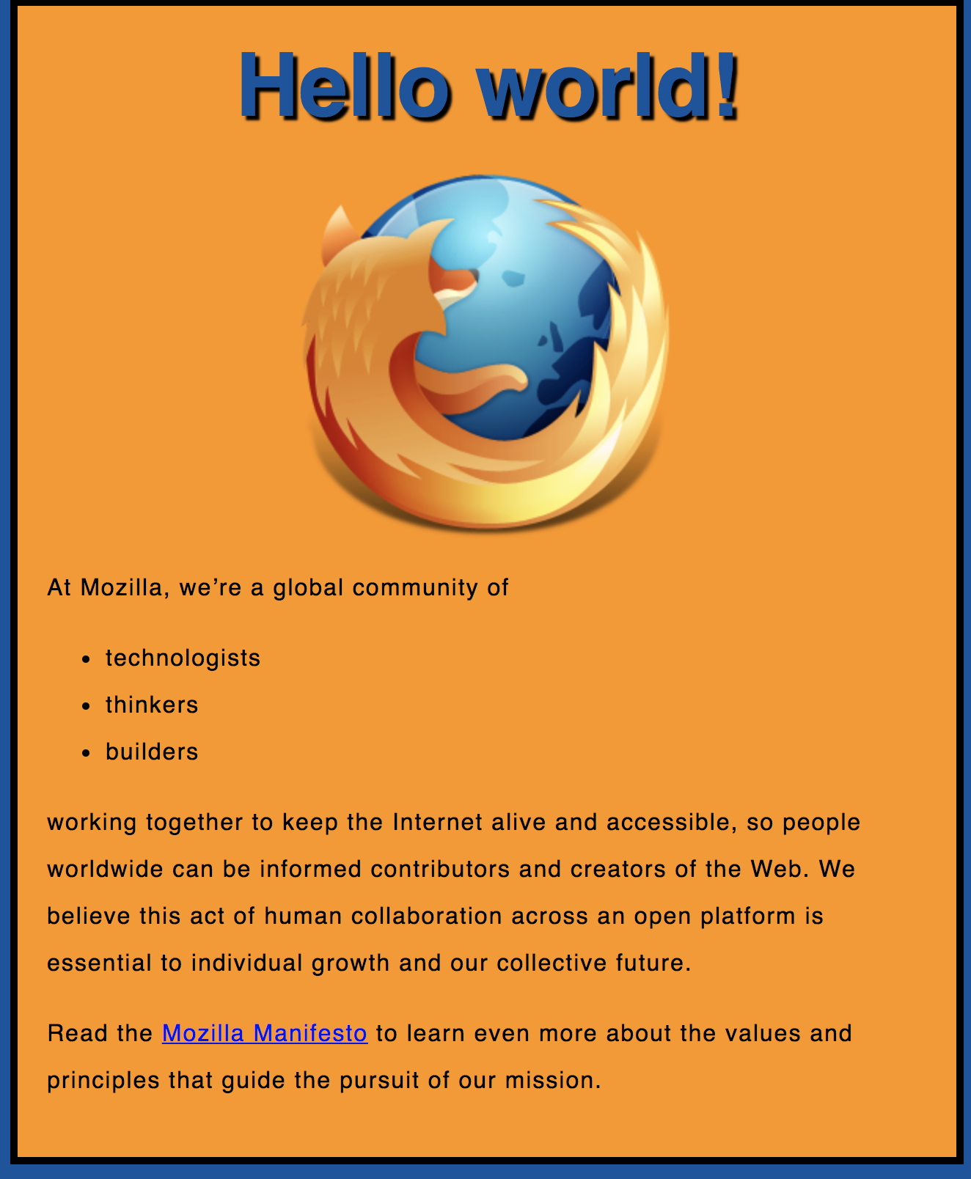
Exercise 1

Slide 30
Exercise 1
Create a new file called main.js
Save it in your scripts folder.

Slide 31
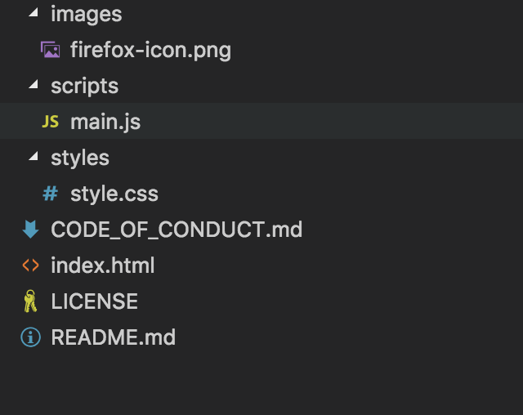

Slide 32
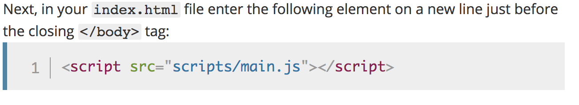
Notes:
<script src="scripts/main.js"></script>

Slide 33
<!DOCTYPE html>
<html>
<head>
<meta charset="utf-8">
<title>My test page</title>
<link href="styles/style.css" rel="stylesheet" type="text/css">
</head>
<body>
<h1>Hello World!</h1>
<img src="images/firefox-icon.png" alt="The Firefox logo: a flaming fox.">
<script src="scripts/main.js"></script>
</body>
</html>
Notes:
Note: The reason we've put the <script> element near the bottom of the HTML file is that HTML is loaded by the browser in the order it appears in the file. If the JavaScript is loaded first and it is supposed to affect the HTML below it, it might not work, as the JavaScript would be loaded before the HTML it is supposed to work on. Therefore, putting JavaScript near the bottom of the HTML page is often the best strategy.

Slide 34
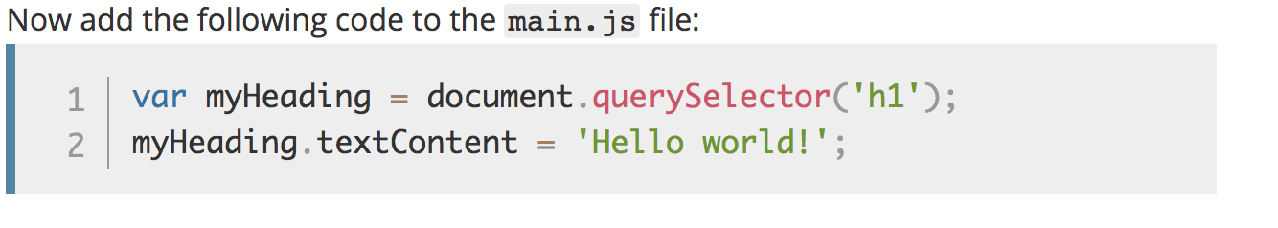
Manipulate HTML/DOM
Notes:
Note: Both of the features you used above are parts of the Document Object Model (DOM) API, which allows you to manipulate documents.
var myHeading = document.querySelector('h1');
myHeading.textContent = 'Hello world!';

Slide 36
Variables

Slide 37
Variables
JavaScript is case-sensitive
var myVar = "foobar";
var MyVar = "foobar";

Slide 38
Variables
var a, b, c;
var a = 3;
var d = 10, e = 10;
f = 22;
var pi = 3.14159;
var s = 'a', t = "t";

Slide 39
Identifiers
Must start with either “$”, “_” or a letter
Subsequent letters can be “$”, “_”, letter, numbers
var 1abc = 3; // Invalid
var $123 = 3; // Valid
Notes:
Identifier = variabelenaam.

Slide 40
Types
“Primitive” value types
Number (floating point)
String
Boolean
null
undefined
Notes:
null = NIL
undefined= niet geinitializeerd.

Slide 41
Built-in values
true & false
null
undefined
NaN (=Not A Number)
Infinity

Slide 42
Conditionals

Slide 43
Conditionals
if (expression1) {
//Executes when expression1 is truthy
} else if (expression2) {
//Executes when expression2 is truthy
} else {
//Executes when none of the above conditions are truthy
}

Slide 44
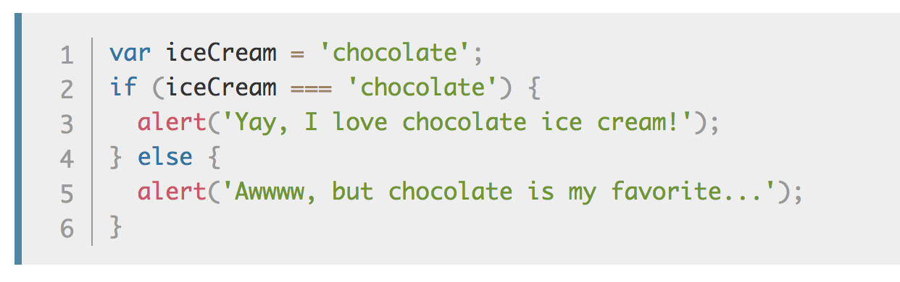
Conditionals

Slide 45
Truthy Falsy
Falsy values:
false, null, undefined, 0, ‘’, NaN
Truthy values:
Everything else

Slide 46
if (null) { // false
} else if (0) { // false
} else if ('') { // false
} else if (1) { // true
}

Slide 47
== vs ===
== performs type coercion
tries to match types for comparison
=== does NOT perform type coercion
will fail if type is different
Notes:
== Coercion: cast gelijk de datatypes.
===

Slide 48
Conditionals

Slide 49
Example
"" === 0 // false
"" == 0 // true
'0' == 0 // true
false == '0' // true
4 != '4' // false
4 !== '4' // true
Try to use ===, !==
instead of ==, !=

Slide 50
Infix operators same as Java
var x = 4;
if (x > 3 && x < 6) {
} else if (x > 3 || x === 2) {
}

Slide 51
Functions

Slide 52
Functions
Functions are objects
Can be created on their own
function foo() {}
Can assigned to a variable
var x = function() {}

Slide 53
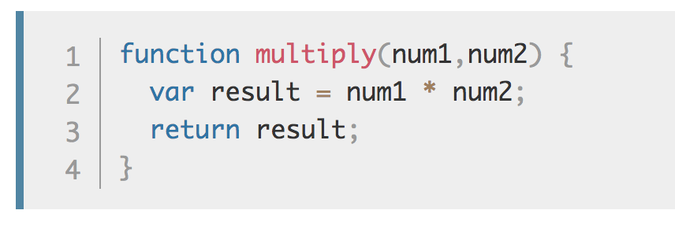
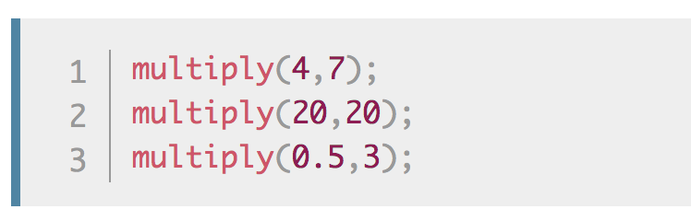
Make your own functions
Notes:
Note: The return statement tells the browser to return the result variable out of the function so it is available to use.
This is necessary because variables defined inside functions are only available inside those functions.
This is called variable scoping.

Slide 54
Use of “var”
Local
When used inside a function
Global
When outside a function
When ‘var’ is omitted (!)

Slide 55
Events
Examples when Events are executed:
clicked on a button
clicked on a page
pressed on enter-key

Slide 56
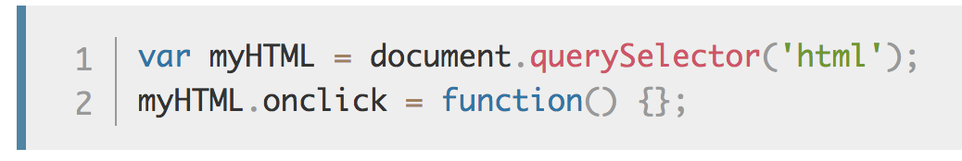
onclick Event

Slide 57
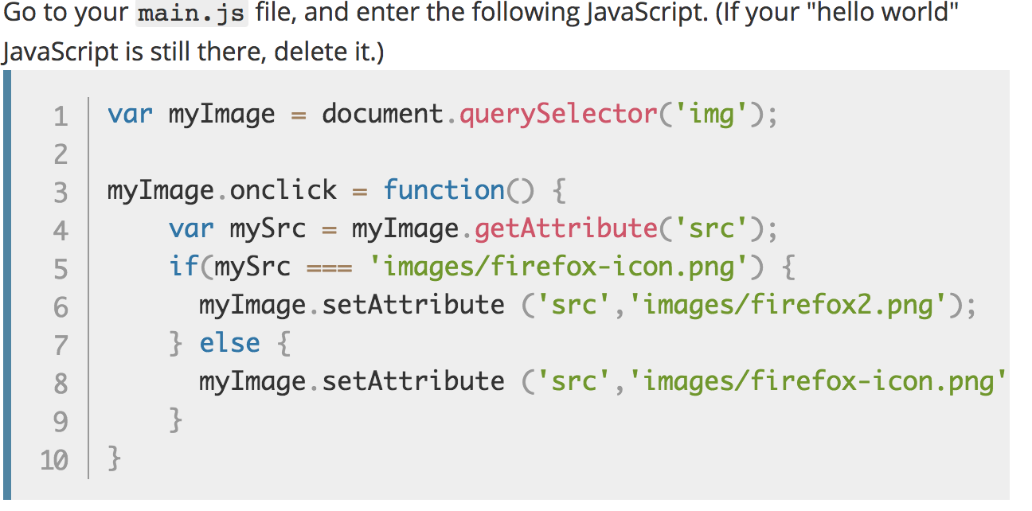
Exercise 2
Notes:
You store a reference to your <img> element in the myImage variable. Next, you make this variable's onclick event handler property equal to a function with no name (an "anonymous" function). Now, every time this element is clicked:
var myImage = document.querySelector('img');
myImage.onclick = function() {
var mySrc = myImage.getAttribute('src');
if(mySrc === 'images/firefox-icon.png') {
myImage.setAttribute ('src','images/firefox2.png');
} else {
myImage.setAttribute ('src','images/firefox-icon.png');
}
}

Slide 58
Exercise 3
Adding a personalized welcome message

Slide 59
Notes:
https://mdn.github.io/beginner-html-site-scripted/

Slide 60
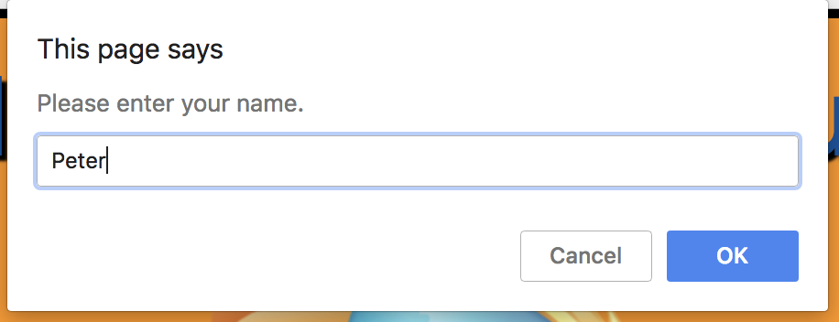

Slide 61
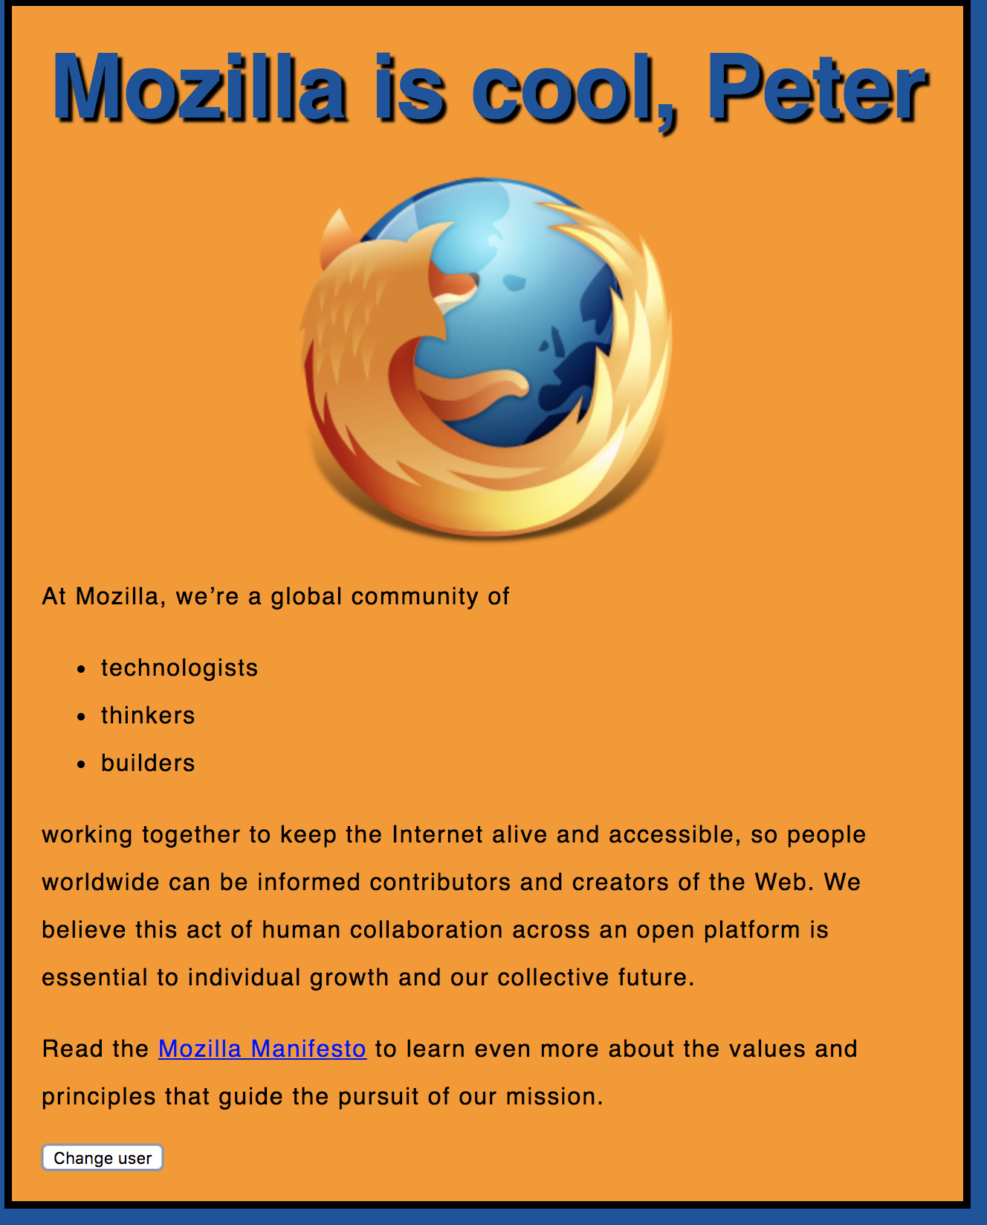

Slide 62
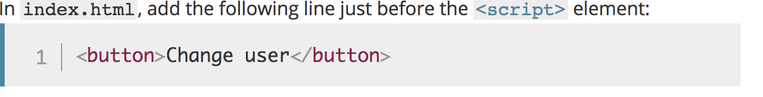

Slide 63
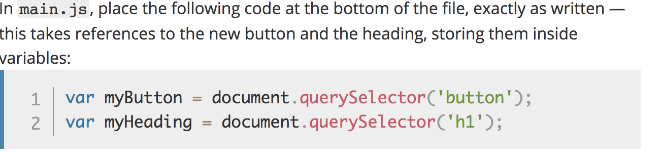
Notes:
var myButton = document.querySelector('button');
var myHeading = document.querySelector('h1');

Slide 64
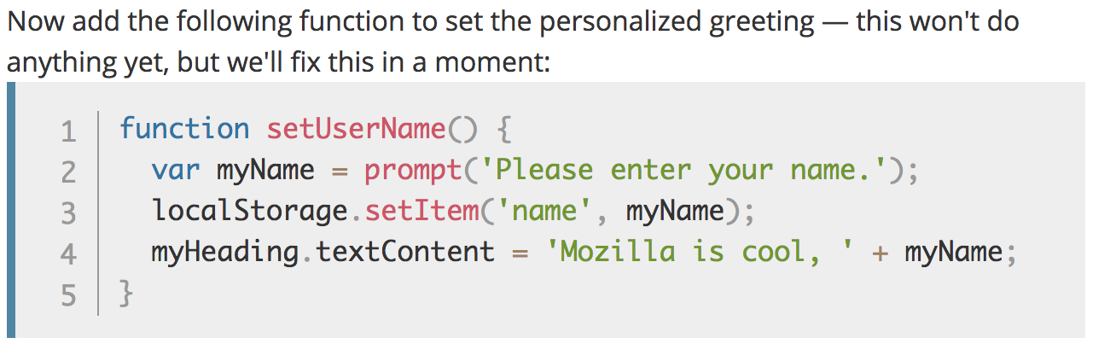
Notes:
function setUserName() {
var myName = prompt('Please enter your name.');
localStorage.setItem('name', myName);
myHeading.innerHTML = 'Mozilla is cool, ' + myName;
}

Slide 65
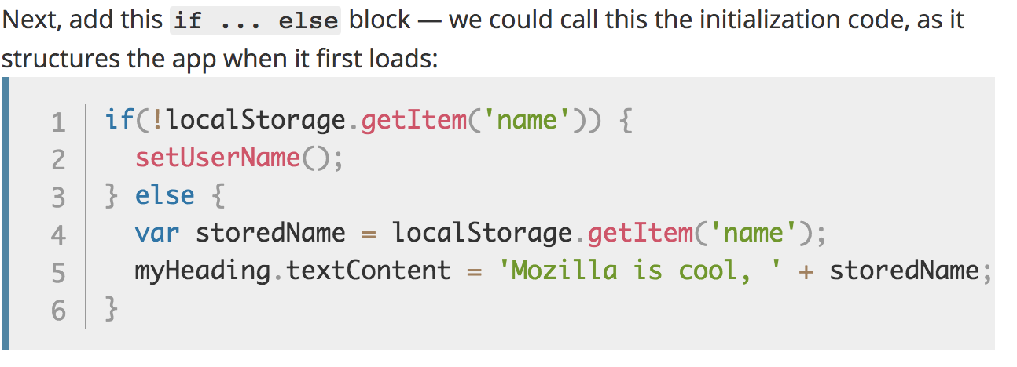
Notes:
if(!localStorage.getItem('name')) {
setUserName();
} else {
var storedName = localStorage.getItem('name');
myHeading.innerHTML = 'Mozilla is cool, ' + storedName;
}

Slide 66
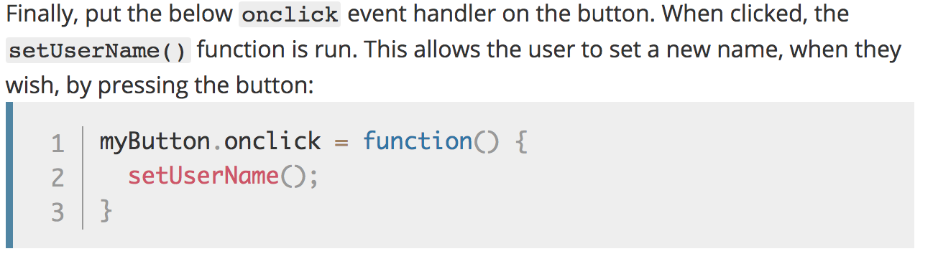
Notes:
myButton.onclick = function() {
setUserName();
}

Slide 67
Solution
https://github.com/mdn/beginner-html-site-scripted/blob/gh-pages/scripts/main.js

Slide 68
Iterators/ Loops

Slide 69
Iterators
while (expression) { .. }
for (init; expression; update) { .. }
for (variable of object) { .. }
for (variable in object) { .. }

Slide 70
var list = [4, 5, 6];
for (var in list) { console.log(i); // "0", "1", "2" }
for (var i of list) { console.log(i); // "4", "5", "6" }

Slide 71
Arrays

Slide 72
Arrays
var beers = ['Heineken', 'Amstel', 'Jupiler'];
var cars = new Array("Saab", "Volvo", "BMW");
console.log(beers.length); // output is 3
var x = beers[0]; // x => 'Heineken'

Slide 73
Arrays
var beers = ['Heineken', 'Amstel', 'Jupiler'];
beers[5] = 'Palm';
console.log(beers.length); // output is 6 (!)
console.log(beers[3]); // output is undefined (!)
beers = [ , 'Heineken', , 'Amstel'];
console.log(beers.length); // output is 4 (!)

Slide 74
Objects

Slide 75
Objects
var car = new Object();
car.make = 'Ford';
car.model = 'Mustang';
car.year = 1969;

Slide 76
Associative Array /
Dictionary
var car = new Object();
car['make'] = 'Ford';
car['model'] = 'Mustang';
car['year'] = 1969;

Slide 77
JSON
var car = {
make: 'Ford',
model: 'Mustang',
year: 1969
};

Slide 78
JSON

Slide 79
JSON
JavaScript Object Notation
A common use of JSON is:
to exchange data to/from a web server.

Slide 80
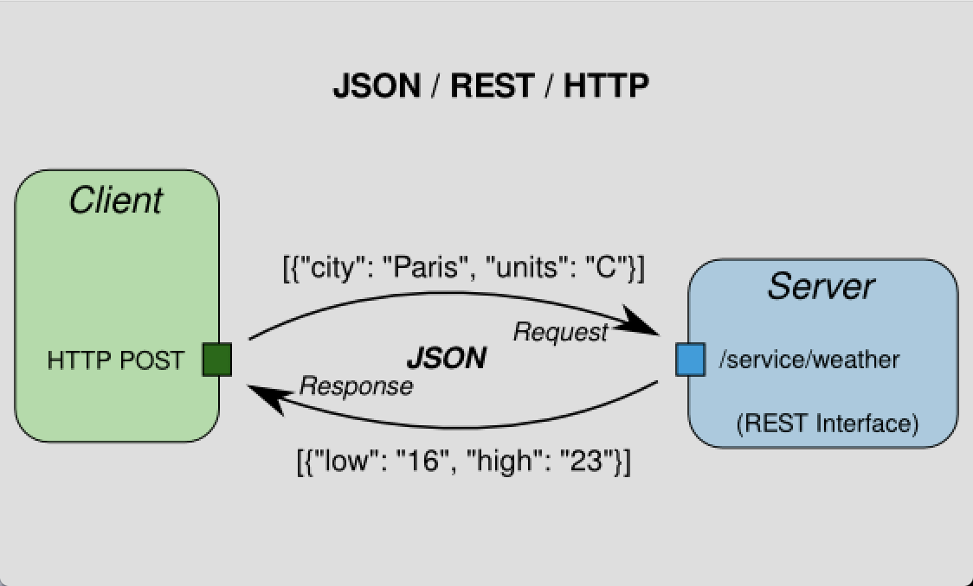

Slide 81
Valid JSON
var obj = {
"name":"John",
"age":30,
"city":"New York”
};

Slide 82
JSON
For parsing use:
var json = JSON.parse('{..}')
var jsonString = JSON.stringify({..});
Notes:
PARSE:
When receiving data from a web server, the data is always a string.
Parse the data with JSON.parse(), and the data becomes a JavaScript object.
STRINGIFY:
When sending data to a web server, the data has to be a string.
Convert a JavaScript object into a string with JSON.stringify().

Slide 84
JSON.parse( )
Parse the data with JSON.parse(), and the data becomes a JavaScript object.
See: https://www.w3schools.com/js/js_json_parse.asp

Slide 85
JSON.stringify( )
Convert a JavaScript object into a string with JSON.stringify().
See: https://www.w3schools.com/js/js_json_stringify.asp

Slide 86
Debugging in Chrome

Slide 87


Slide 88
Node.js provides a JavaScript runtime environment

Slide 89
Goals
Provide a JavaScript runtime environment
Event-driven, non-blocking I/O
fast/lightweight

Slide 90
Applications
Can be used to create Tools, applications or services
Powered by Chrome’s V8 JavaScript engine
npm, package ecosystem

Slide 91

History
First written in 2009
By Ryan Dahl
2010 package manager npm
2011 native Windows version

Slide 92
Utilities
Node comes with the following:
I/O, Sockets(http/dns/udp/etc), crypto functions, data streams
Runs on Linux, Mac, Windows

Slide 93
Opdracht Node
Open map:
2- Node
Opdracht:
Implement a directory walker

Slide 94
Opdracht Node
How to read recursively a directory in Node.js

Slide 95
Readme
Open Readme for instructions

Slide 96
Package.json
Package.json is important for NPM.
With this file you can declare all your dependencies and install them.

Slide 97
Step 1
Open your prompt/shell/terminal in the root directory
and type: `npm install --save filewalker`

Slide 98
What is generated
A couple of things have happened:
NPM installed the `filewalker` dependency locally in the node_modules folder
NPM add `filewalker` to the dependency list in package.json

Slide 99
Great!
This means that we are now able to use this dependency.

Slide 100
Step 2 Use the dependency
Open:
`nodeScript.js`

Slide 101
First we need to require the dependency.
Add the following in your nodeScript:
const filewalker = require('filewalker');

Slide 102
Step 3
Using the following code we can traverse a directory:
filewalker('A_DIRECTORY')
.on('dir', p => console.log('dir: %s', p))
.walk();

Slide 103
Step 4 Execute script
node nodeScript.js

Slide 104
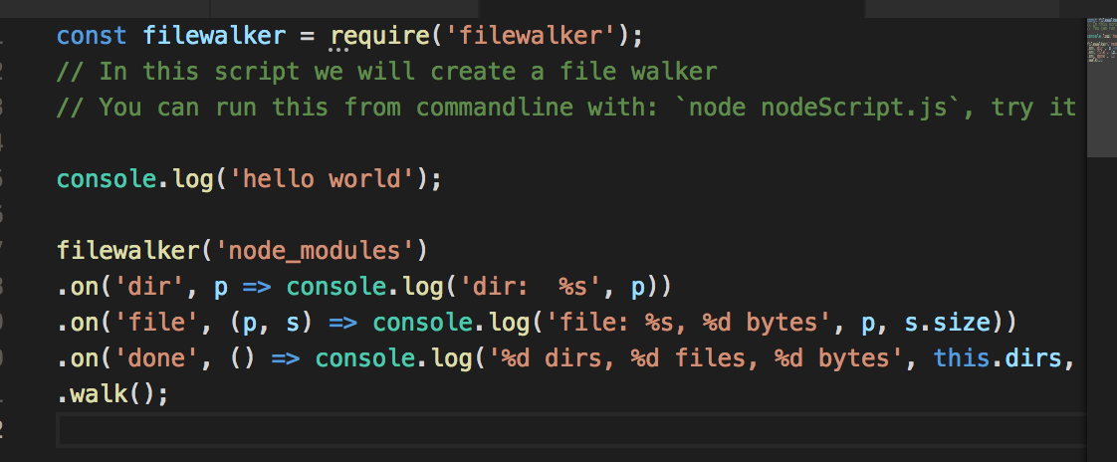
Notes:
filewalker('node_modules')
.on('dir', p => console.log('dir: %s', p))
.on('file', (p, s) => console.log('file: %s, %d bytes', p, s.size))
.on('done', () => console.log('%d dirs, %d files, %d bytes', this.dirs, this.files, this.bytes))
.walk();

Slide 105
Exercise create REST-API
https://www.codementor.io/wapjude/creating-a-simple-rest-api-with-expressjs-in-5min-bbtmk51mq

Slide 106
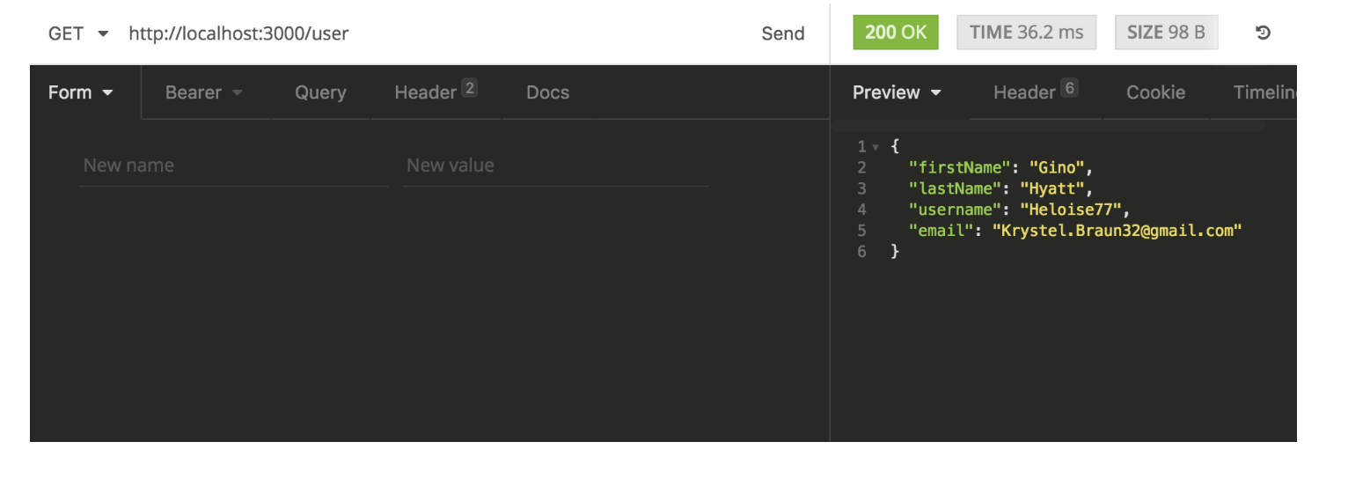

Slide 107
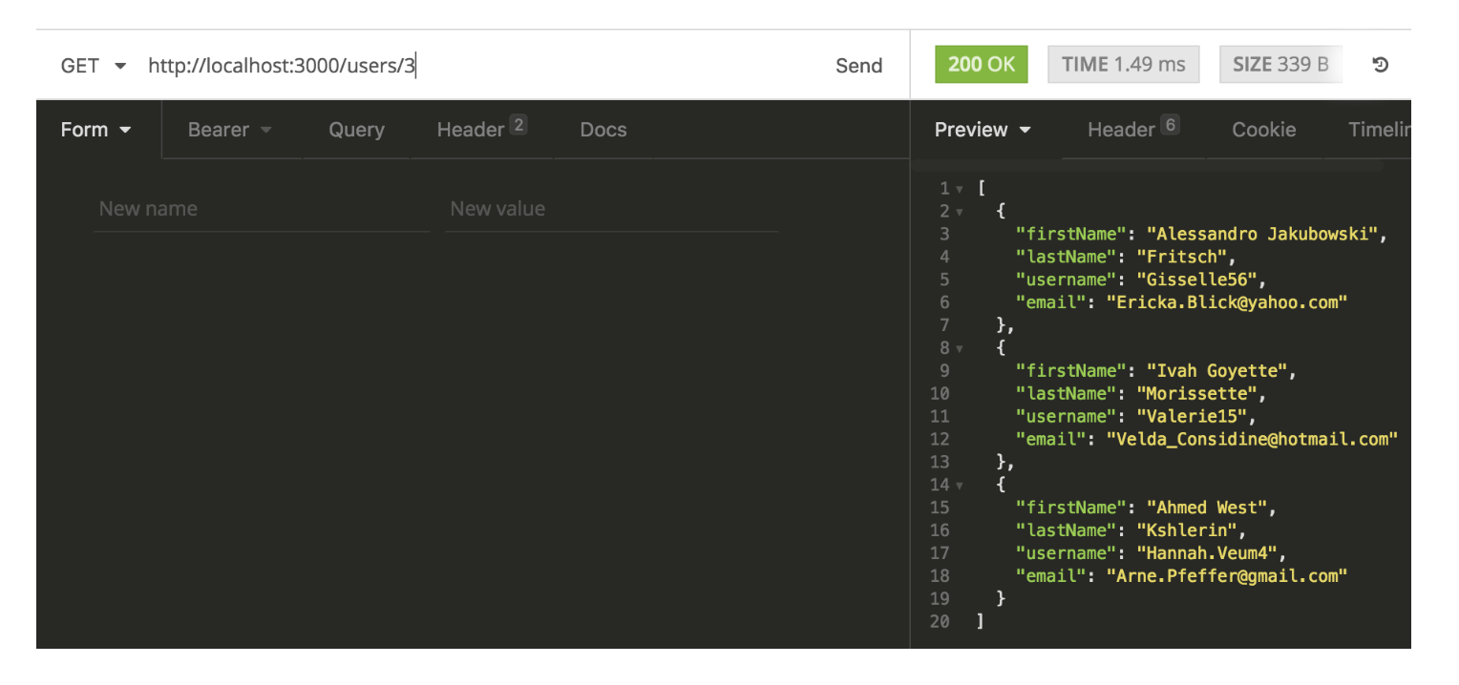

Slide 108
Building blocks
Node.js
ExpressJS: for REST API
body-parser
Faker: generate random user account details

Slide 109
Async Programming
Notes:
Voorbeeld Whatsapp. Async communcatie met messaging.
Why Axios?

Slide 110
What is HTTP?
HTTP works as a request-response protocol between a client and server.
Notes:
A web browser may be the client, and an application on a computer that hosts a web site may be the server.
Example: A client (browser) submits an HTTP request to the server; then the server returns a response to the client. The response contains status information about the request and may also contain the requested content.

Slide 111
HTTP Methods
GET
POST
PUT
HEAD
DELETE
PATCH
OPTIONS

Slide 112
GET Method
GET is used to request data from a specified resource over HTTP.

Slide 113
POST Method
POST is used to send data to a server to create/update a resource.

Slide 114
PUT is idempotent
https://developer.mozilla.org/en-US/docs/Glossary/Idempotent

Slide 115
HTTP Request Methods
https://www.w3schools.com/tags/ref_httpmethods.asp

Slide 116
Exercise

Slide 117
Sync vs Async Programming
Notes:
Voorbeeld Whatsapp. Async communcatie met messaging.
Why Axios?

Slide 118
Async Programming
By sending asynchronously, the JavaScript does not have to wait for the server response, but can instead:
execute other scripts while waiting for server response
deal with the response after the response is ready

Slide 119
Promise Syntax
Service.get()
.then(x => console.log(x)) → onsucces
.catch(error => console.log(error)) → onerror

Slide 120
Async with AXIOS
Promise based HTTP client for the browser

Slide 121
CORS
Cross-Origin Resource Sharing (CORS) is a technique for relaxing the same-origin policy, allowing Javascript on a web page to consume a REST API served from a different origin.

Slide 122
CORS

Slide 123
CORS

Slide 124
Exercise Full stack 1 + 2
https://itnext.io/learn-how-full-stack-apps-work-by-building-a-simple-one-using-javascript-part-1-38e237694012
https://
Notes:
https://codeburst.io/build-a-weather-website-in-30-minutes-with-node-js-express-openweather-a317f904897b

Slide 125
configure the CORS
see: www.npmjs.com/package/cors

